Slide 1

Rev: November 2017
Health, Safety & Environmental Induction

Slide 2
Health, Safety and Environmental
Larne Harbour Limited is committed to:
Protecting the Health, Safety and Welfare of its employees and those affected by its activities.

Slide 3
HSE Policy
Committed to
Achieving best possible HSE Protection
Continual improvement
Continually reduce accidents
Identify hazards, control risk and encourage intervention by staff.
Encourage openness in sharing learning events.

Slide 4

Health & Safety at Work Order
Employers Responsibilities:
The provision and maintenance of plant and systems of work
Arrangements for ensuring, so far as is reasonably practicable, safety and absence of risks to health in connection with handling, storage and transport of articles and substances.
Provision of information, instruction, training and supervision

Slide 5
Health and Safety at Work Order
Employers Responsibilities continued:
Provision and maintenance of safe place of work
Provision and maintenance of a safe working environment
Provision and maintenance of a policy
Consult and work with a H&S Representative.
Provide and maintain a Safety Committee.

Slide 6

Health & Safety at Work Order
Employees Legal Responsibilities
Take reasonable care of your own health and safety and that of other who may be affected by your works.
To co-operate with their employer with regards to health and safety.
Shall not intentionally or recklessly interfere with or misuse anything provided in the interest of health, safety or welfare. i.e. PPE, equipment

Slide 7
Larne Port
Consists of secure and unsecure areas
Security, Access and Egress
Safe Systems of Work
Emergency Procedures

Slide 8

Larne Port – Security
International Ship and Port Facility Security (ISPS) Code Site
Secure areas – with 24 / 7 Security
Controlled access and egress
CCTV in operation

Slide 9



Port Rules
Hi Viz Clothing as a minimum must be worn.
Additional PPE in line with task specific or area specific risk assessments.
Wear your security pass at all times.
If on foot use designated walkways.
Speed limit in Port is 15mph, comply with road layout, all road markings and road signs.
Vehicles must be parked in designated parking areas.
Life vests to be worn when 1m away from open Quay Edge

Slide 10



Port Rules
Vehicles must have flashing indicators on or flashing beacon on when driving through Port.
Report all accidents, near misses and safety observations to Port Control.
Remain in agreed authorised areas.
Maintain good personal hygiene – protection against Weil's Disease.
Be aware and take care of moving traffic.
No cycling within Port.

Slide 11
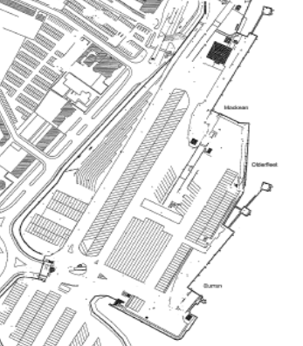

Port Rules
Do not drive under MacKean Ramp as a through way.
Do not drive across P&O Freights lanes (marked in yellow) as a short cut.
Remain on designated road ways.

Slide 12

Accident Prevention
Report all defects, Haz Obs and Near Misses to Port Control
Defects
  Maintenance / repairs required for premises, harbour area and general infrastructure.
Hazardous Observation
  An incident or circumstance which has the potential to cause an accident.
Near Miss
  An incident which has happen, but although not having caused an injury or damage, had to potential to do so.

Slide 13
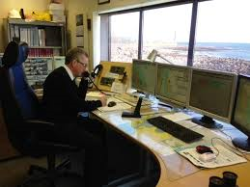
Larne Port Emergency Number
In the event of any accident, environmental incident, or if you require Port Assistance please contact:
Larne Port Control: 028 2887 2222

Slide 14

Emergency Arrangements
Report all accidents / emergencies to your supervisor and / or a member of Larne Port Staff.
In an emergency contact Port Control on 028 2887 2222
First Aider and First Aid Kits are located designated areas marked with white cross on green back ground.
Ensure you have this number
saved on your phone

Slide 15
Emergency Arrangements
Report all accidents, no matter how minor.
Accidents are logged by Port to ensure injuries are treated correctly.
All accidents are investigated for the purpose of identifying how it happened and implementing controls to prevent it happening again.
All accidents are gathered for analysis for identifying preventive action.
Larne Port Control: 028 2887 2222

Slide 16

Fire Emergency Procedure
Raise Alarm (Shout fire, fire, fire) and activate a nearest break glass.
Exit building and go straight to allocated assembly point
Inform Port Control of location and detail of alarm.
Only attempt to extinguish fire if safe to do so and you have been trained in the use of Fire Extinguishers.
Remain at Assembly Point until instructed by appointed Fire Marshall

Slide 17



Fire Emergency Procedures
Upon hearing the Fire Alarm proceed immediately and calmly to the relevant Assembly Point.
Following instructions issued to you by Fire Wardens or Fire Marshalls – G4S, Larne Port & P&O Staff.
Only re enter the building / area once Fire Marshall has issued the all clear.

Slide 18

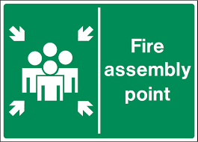


Emergency Arrangements
Locations:
Front entrance to Passenger Terminal
G4S Response Vehicle
P&O Stevedore Welfare Hut MacKean Ramp

Slide 19

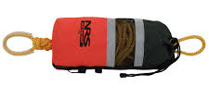

Working near water
Life vests must be worn if Operative is standing or working within 1m of open quay.
Life rings are located along all quays.
Chains are attached between all access ladders to aid persons in water to reach ladders.
Notify Port Control of any incident involving persons falling into water
Assist person in water by throwing life ring / throw rope.
Shout for assistance and always keep eye contact with person.

Slide 20

Smoking Policy
Smoking is illegal inside buildings and in company vehicles.
Ensure that you put your cigarette out properly once it is finished.
Do not smoke near fuel containers or bunded areas.

Slide 21



Mobile Phone Use
The use of mobile phones while driving is illegal.
Mobile phones should only be used in the Port Areas when:
  You are sitting in you vehicle, parked in a designated space.
  In a safe area (i.e. on designated walkway / behind barrier away from moving vehicles), where you are away from moving traffic and work activities and you remain static.
  Do not walk about while you are on the phone.

Slide 22



Welfare
Toilets at MacKean Ramp and within Passenger Terminal.
Hand washing facilities located in Toilets.
Café in Passenger Terminal
Shower in Passenger Terminal

Slide 23



Housekeeping
Do not leave items lying around.
Tidy up area after yourself.
Rubbish must be disposed of in designated bins, or taken away with you.
Ensure all materials, documents and equipment are stored securely.

Slide 24



Security
Access to security area at Passenger Terminal is via:
  Tickets
  Security Passes – visitors
  Security Passes – Staff / Contractors
Wear Passes at all times. Must be visible.
Remain in designated areas.
If you see anything suspicious or you have any concerns please speak to a member of the G4S Security Team or a member of staff.

Slide 25


Environmental
Larne Port maintain spills kits within designated areas.
Environmental Incident Bay located opposite south end gate.
All contractors are required to hold spill kits within their work area and with mobile plant.
All spills must be cleaned up.
All spills must be reported to Larne Port Control 028 2887 2222
Spills are to be prevented to reach drains / harbour waters.
If Larne Port Spill Kits or incident bay are used
Report immediately to Larne Port Control

Slide 26


Safety Culture
Safety First
STARTS WITH US ALL

Slide 27

Safe Attitudes
S: Support
E: Engage
A: Apply
L: Learn
Provide your backing and commitment to working safely so no one gets hurt.
Proactively participate in and enhance safe work practices to keep yourself, work colleagues and others safe.
Employ your knowledge, positive attitude, training and education in doing things right first time and in a safe manner.
Ensure that lessons are learnt from past performances and incidents so we continually improve our safe work practices.

Slide 28
HSE Everyone’s Responsibility
Report any suspicious activity to harbour security.
Help prevent accidents by identifying and dealing with Safety Observations and Near Misses.
Report all accidents and incidents.
Familiarise yourself with your risk assessments and safe systems of work.
Follow instructions within this induction.
Be aware of moving traffic in operational areas – use walkways.
Exercise extreme caution whilst in the Port Area.
Always be away activities in operation around you.

Slide 29
Test

